Slide 1
Software Process Model
Week 5

Slide 2
Outline
SDLC Models
  Sequential model
    Waterfall model.
    V-model
  Incremental model
    Evolutionary Model
    Incremental Development
    Spiral model
    Agile Development

Slide 3
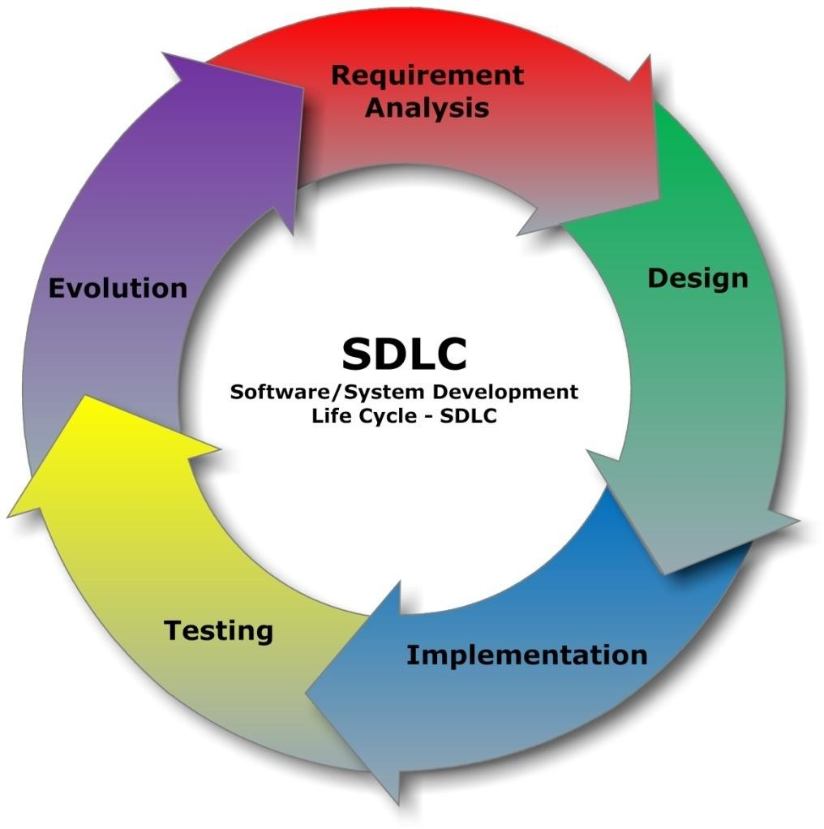
Agile Development

Slide 4
What is Agile?
Agile software development is a group of software development methodologies based on iterative and incremental development, where requirements and solutions evolve through collaboration between self- organizing, cross-functional teams.
Delivering working software quickly
Welcoming changes anytime

Slide 5
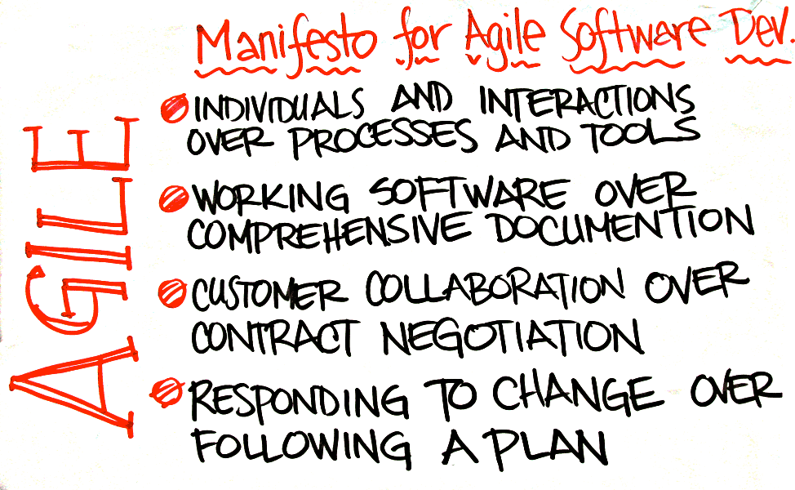

Slide 6
SCRUM
Scrum is an iterative, incremental framework seen in agile software development
It defines a set of activities that can help your team deliver more value to your customers faster.
These activities provide your customers with the opportunity to review, guide and influence your team's work as it progresses.
This approach does not attempt to define everything at the start of a project. Instead, your team works in short iterations (also called sprints) and refines the plan as the team makes progress.

Slide 7
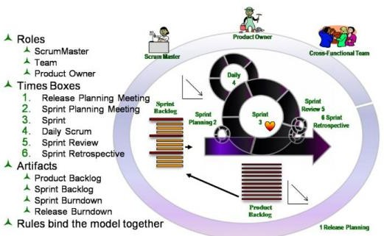
A Model of SCRUM

Slide 8
Scrum Roles
Scrum Master
Team
Product Owner

Slide 9

The SCRUM Master
In the Scrum process, Facilitates the process, removes obstacles, ensures Scrum rules are followed.
The job of the scrum master is to make sure that the project is progressing smoothly
He sets the meetings, monitor the work
and facilitate
Two important task of scrum master are:
▫ Protecting the team from outside disturbance
▫ Clears the ways for the team by helping them to solve their problems

Slide 10
The SCRUM Team
In Scrum, an ideal team would include seven members, plus or minus two. Usually, teams are comprised of cross-functional members, including software engineers, architects, programmers, analysts, QA experts, testers, UI designers, etc. It is recommended all team members be located in the same room, called the team room.
The team has the autonomy to determine how and when to complete its work. As long as the team finishes its work by the deadline and under budget, it is entirely up to the team to determine how that happens.

Slide 11
The Product Owner
In Scrum, the Product Owner is the one person responsible for a project’s success.
The Product Owner outlines work in the Product backlog
Product Owner makes sure that right features to be included in the product backlog
Of course, he or she must also consider the stakeholders (to make sure their interests are included in the release) and the team (to make sure the release is developed by the deadline and within budget).

Slide 12
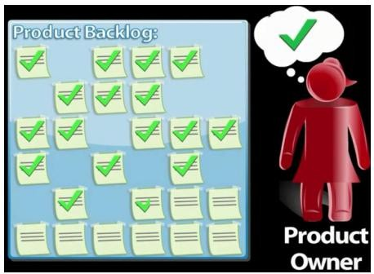
The Product Owner
1

Slide 13
Scrum Artifacts
Product Backlog
Sprint Backlog
Sprint
Burn down Chart

Slide 14
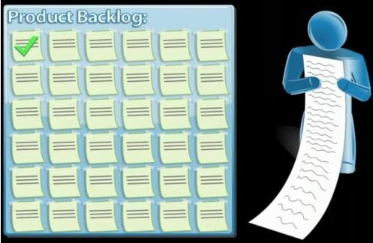
Product Backlog
Contains all the currently known requirements for a product
Is managed by the Product Owner and can change as needed

Slide 15
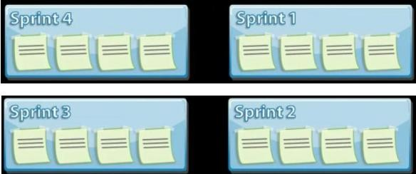
Sprint Backlog
Contains the set of prioritized Product Backlog items that are currently being worked on

Slide 16
Sprint
The product is developed in a series of 1-to-4-week iterations, or sprints. Before a sprint is begun, a Sprint Planning Meeting is held to determine what features are to be implemented in that sprint. The sprint has 4 major steps:
▫ Develop the product further - implement, test, and document.
▫ Wrap up the work - get it ready to be evaluated and integrated.
▫ Review the work done in this sprint.
▫ Adjust for any changes in requirements or plans.
Results in an incremental delivery of usable product

Slide 17
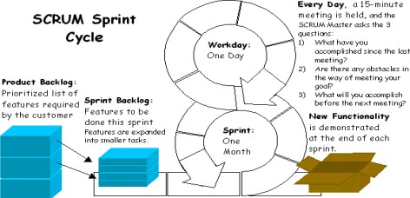
Sprint

Slide 18
Sprint Burn down Chart
The estimated work remaining in the sprint is calculated daily and graphed, resulting in a Sprint Burn down Chart
The vertical axis displays the hours of effort
remaining for the Sprint.
The horizontal axis displays the days of the Sprint.
The burn down is supposed to be shown by the line of descent from the start of the Sprint with the starting hours, down to the end of the Sprint with no hours remaining.

Slide 19
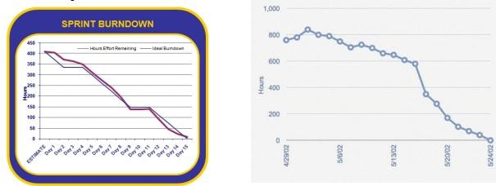
Sprint Burn down Chart

Slide 20
Scrum Meetings
Release Planning Meeting Sprint Planning Meeting Sprint Review Meeting Sprint Retrospective Meeting Daily Scrum Meeting

Slide 21
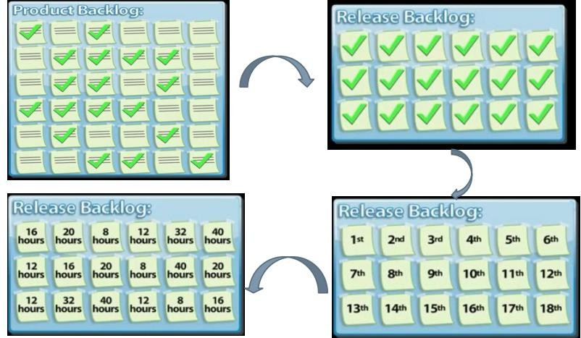
Release Planning

Slide 22
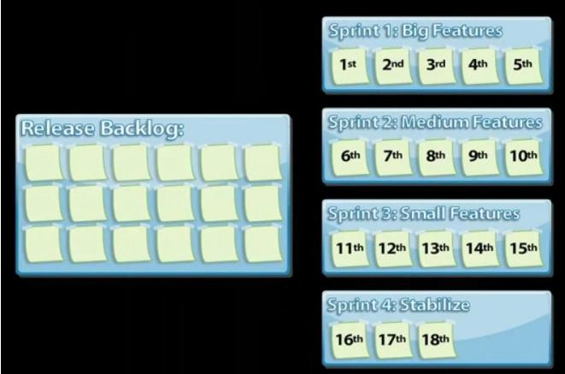
Release Planning

Slide 23
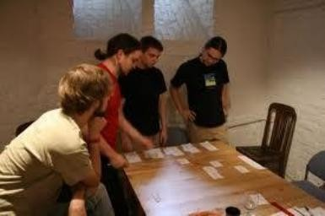
Sprint Planning Meeting
A meeting at the beginning of a sprint where the sprint is planned.
Items from the Product Backlog are selected to be completed in the sprint, based on the priorities set by the Product Owner . Eight hour time limit.
▫ (1st four hours) Product Owner + Team: dialog for prioritizing the
Product Backlog
▫ (2nd four hours) Team only: hashing out a plan for the Sprint, resulting in the Sprint Backlog

Slide 24


Sprint Review Meeting
Review the work that was completed and not completed
Present the completed work to the stakeholders (a.k.a. “the demo”)
Incomplete work cannot be demonstrated

Slide 25
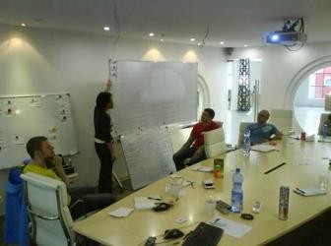
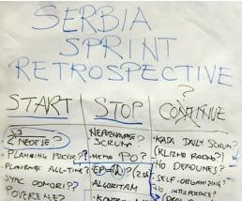
Sprint Retrospective Meeting
The sprint retrospective meeting is time boxed to 3 hours.
It is attended only by the team, the scrum master and the product owner . The product owner is optional.
Make continuous process improvements
Start the meeting by having all team members answer two
questions;
▫ What went well during the sprint?
▫ What could be improved in the next sprint?

Slide 26

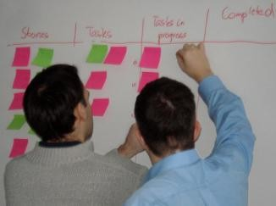

Daily SCRUM Meeting
Brief „Stand-up‟ meeting each morning with SCRUM Team only
Duration is 15 min
Three questions are asked
▫ What value did you add yesterday?
▫ What value will you add today?
▫ What will stop you making progress?

Slide 27
Some Agile Methodologies
Scrum
Extreme Programming (XP)
Feature-Driven Development (FDD)
Adaptive Software Process
Crystal Light Methodologies
Dynamic Systems Development Method (DSDM)
Lean Development

Slide 28

Questions?

